Slide 1




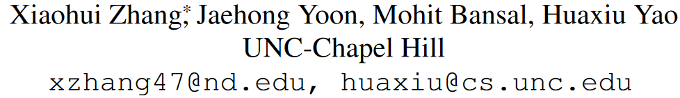



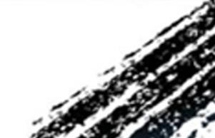

ATAI
Advanced Technique of Artificial Intelligence
ATAI
ChongqingUniversity _{AdvancedTechniqueof}
of Technology Artificial Intelligence
Chongqing University of Technology
Chongqing University ^{ATAI}
_{of Technology} Advanced Techniqueof
Artificial Intelligence
Chongqing University of Technology
Chongqing University of Technology
Multimodal Representation Learning by Alternating Unimodal Adaptation
code:https://github.com/Cecile-hi/MLA.
—— CVPR 2024
Reported by Shu Ming Jiang
1

Slide 2
ATAI
Advanced Technique of
Artificial Intelligence
ATAI
ChongqingUniversity _{AdvancedTechniqueof}
of Technology Artificial Intelligence
Chongqing University of Technology
Motivation
1)Some modalities are more dominant than others, so the model will optimize for these dominant modalities and tend to ignore others, resulting in suboptimal performance.
2)Unlike previous works, our proposed MLA is broadly applicable to traditional multimodal learning tasks as well as challenging scenarios with missing modality data.

Slide 3
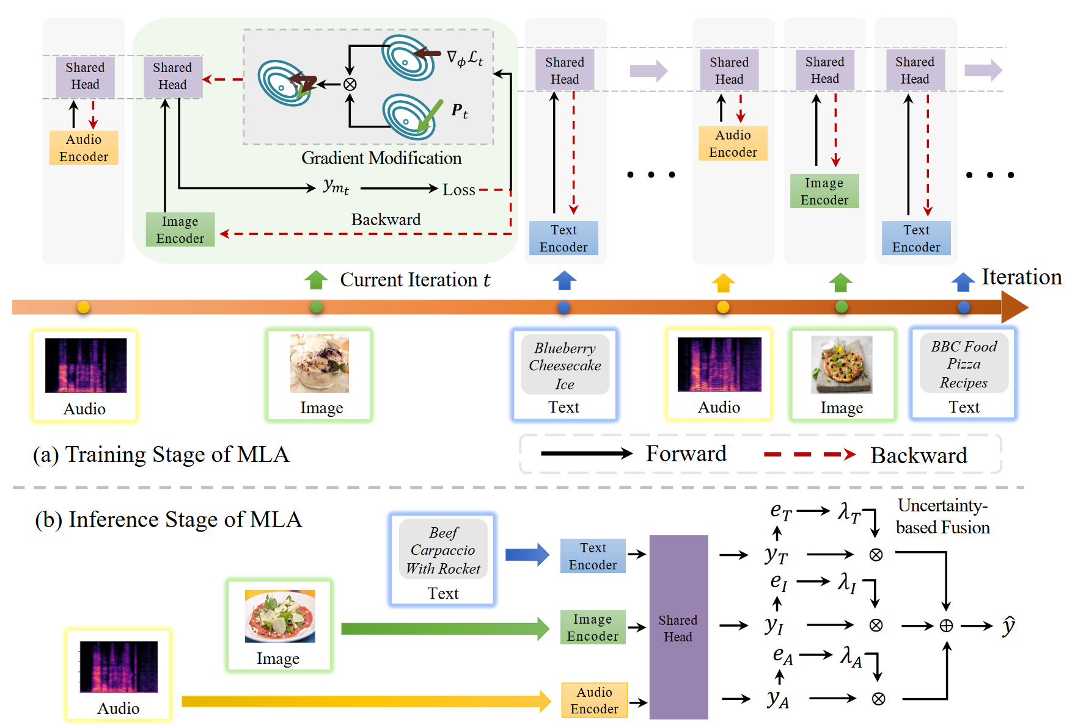
ATAI
Advanced Technique of
Artificial Intelligence
ATAI
ChongqingUniversity _{AdvancedTechniqueof}
of Technology Artificial Intelligence
Chongqing University of Technology
Overview

Slide 4
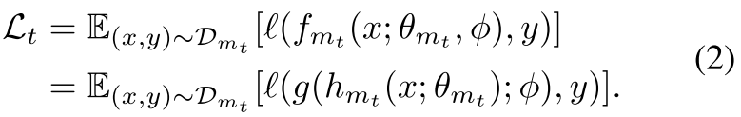
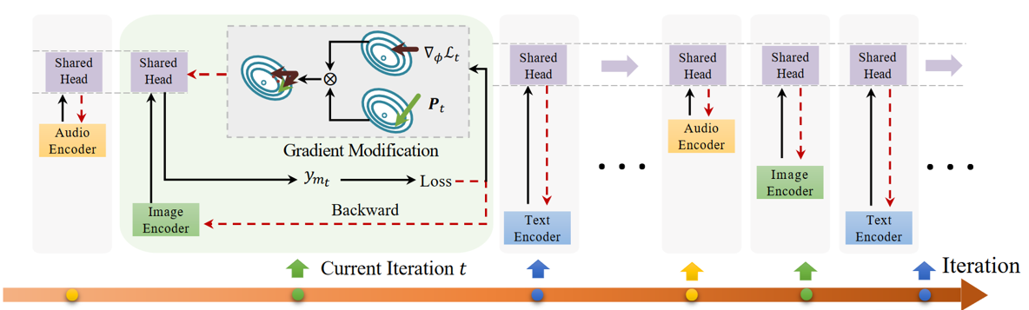
ATAI
Advanced Technique of
Artificial Intelligence
ATAI
ChongqingUniversity _{AdvancedTechniqueof}
of Technology Artificial Intelligence
Chongqing University of Technology
Method
Alternating Unimodal Learning

Slide 5
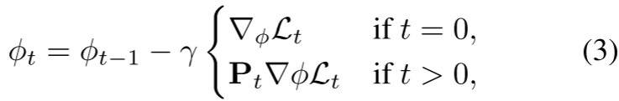
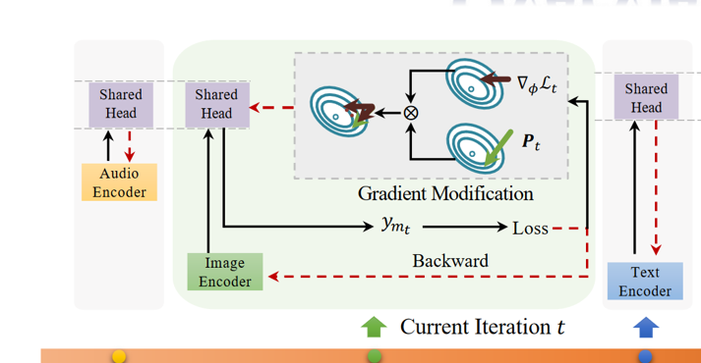
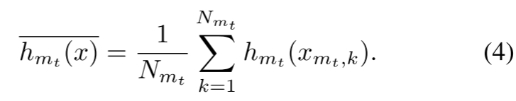
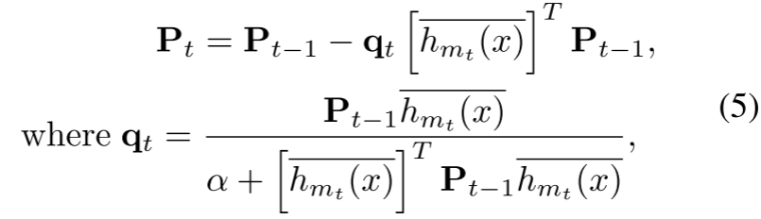
ATAI
Advanced Technique of
Artificial Intelligence
ATAI
ChongqingUniversity _{AdvancedTechniqueof}
of Technology Artificial Intelligence
Chongqing University of Technology
Method
Learning Cross-Modal Information without Modality Forgetting

Slide 6
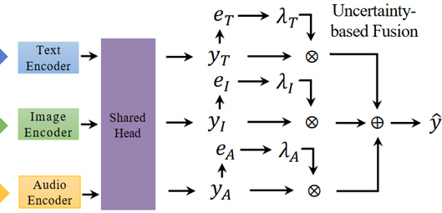
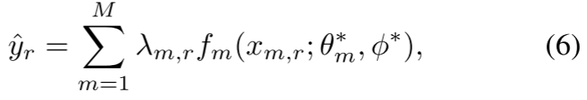
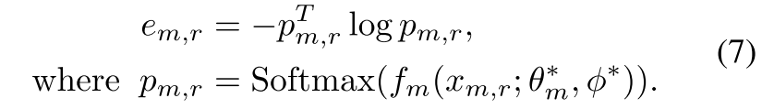
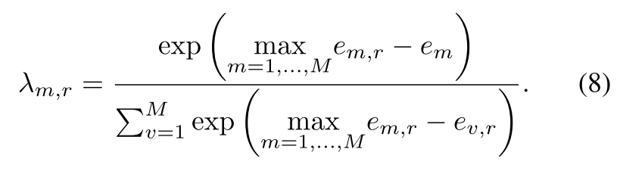
ATAI
Advanced Technique of
Artificial Intelligence
ATAI
ChongqingUniversity _{AdvancedTechniqueof}
of Technology Artificial Intelligence
Chongqing University of Technology
Method
Test-Time Dynamic Modality Fusion

Slide 7
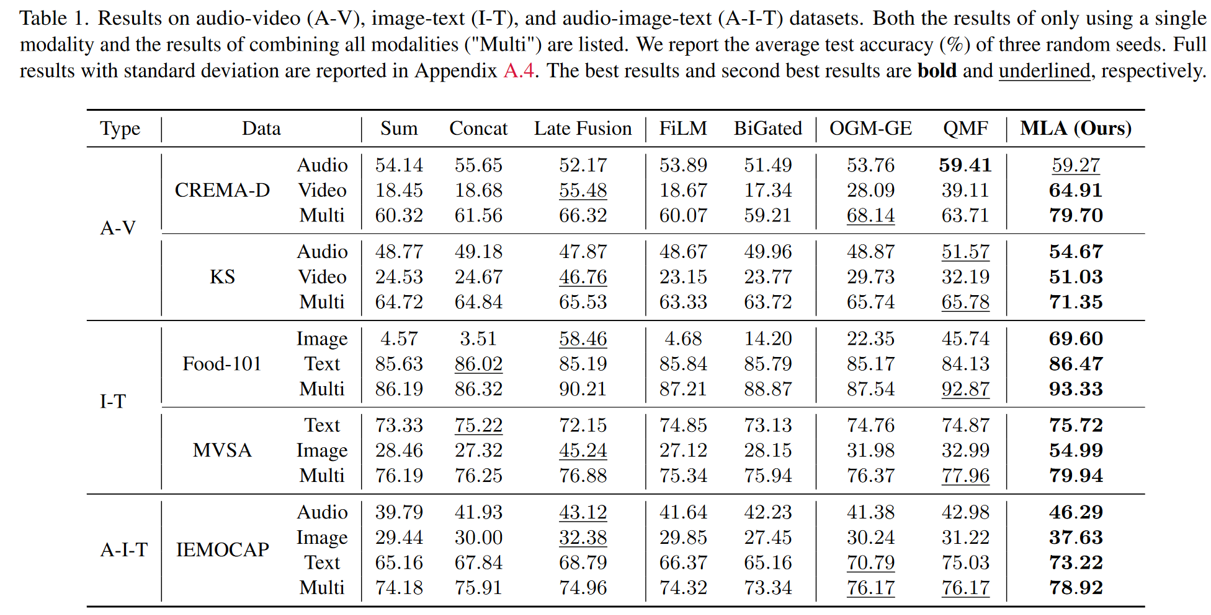
ATAI
Advanced Technique of
Artificial Intelligence
ATAI
ChongqingUniversity _{AdvancedTechniqueof}
of Technology Artificial Intelligence
Chongqing University of Technology
Experiments

Slide 8
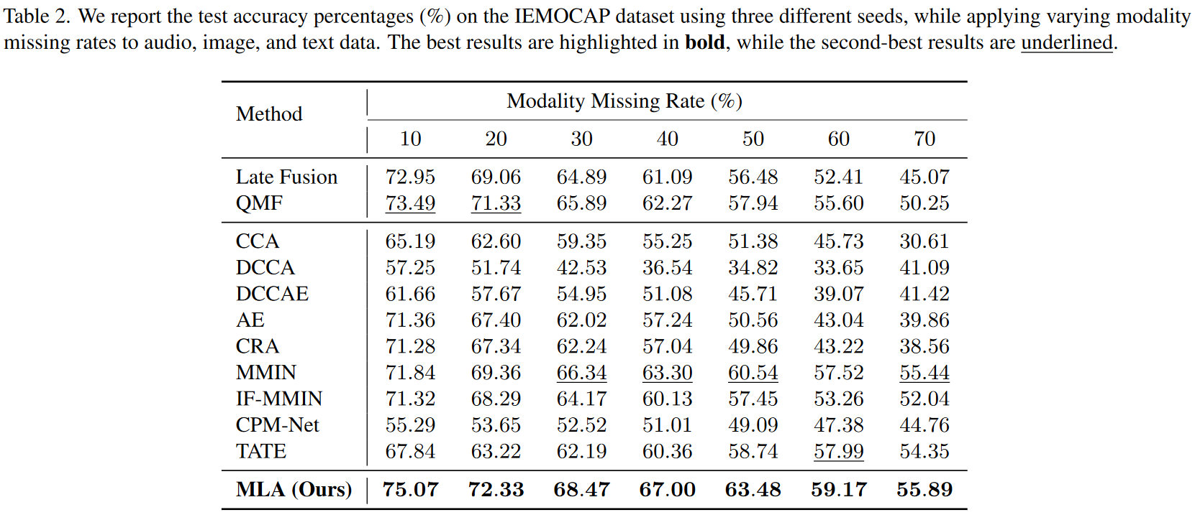
ATAI
Advanced Technique of
Artificial Intelligence
ATAI
ChongqingUniversity _{AdvancedTechniqueof}
of Technology Artificial Intelligence
Chongqing University of Technology
Experiments

Slide 9
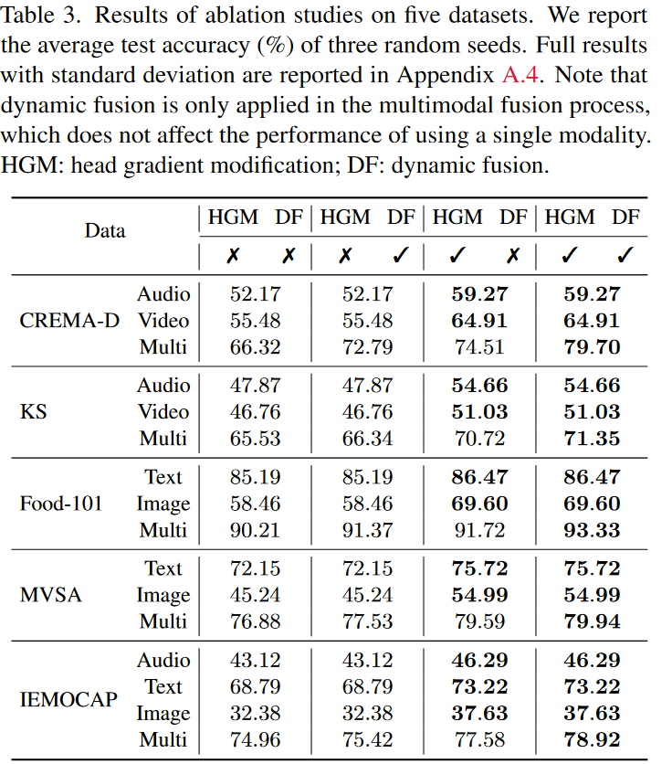
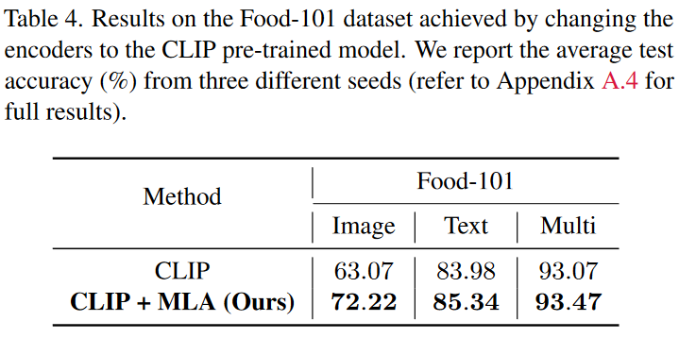
ATAI
Advanced Technique of
Artificial Intelligence
ATAI
ChongqingUniversity _{AdvancedTechniqueof}
of Technology Artificial Intelligence
Chongqing University of Technology
Experiments

Slide 10
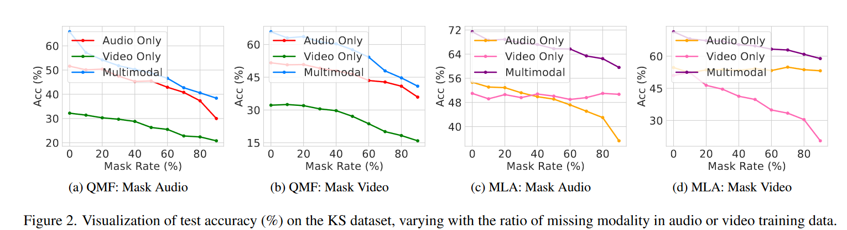
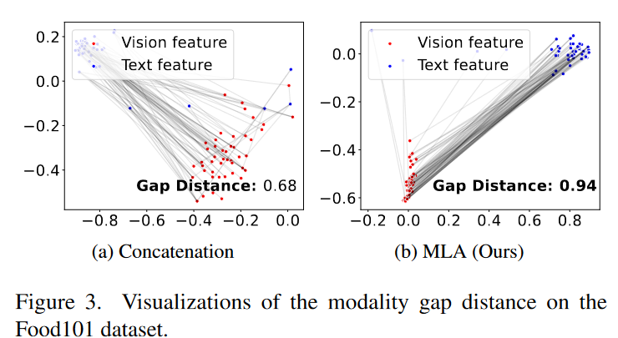
ATAI
Advanced Technique of
Artificial Intelligence
ATAI
ChongqingUniversity _{AdvancedTechniqueof}
of Technology Artificial Intelligence
Chongqing University of Technology
Experiments

Slide 11


ChongqingUniversity of Technology
ATAI
Advanced Technique of
Artificial Intelligence
ATAI
ChongqingUniversity _{AdvancedTechniqueof}
of Technology Artificial Intelligence
Chongqing University of Technology
Thanks!

